Slide 1

SDN Workshop 2014
Load Balancer
Hanan Rofe Haim
Elad Levi
SDN Workshop 2014
Load Balancer

Slide 2
Project Description
A dynamic load balancer according to current traffic status.
Special Feature:
“Cross-Entrance Consistent Range Classifier with OpenFlow”
According to an article by Yehuda Afek, Anat Bremler-Barr And Liron Schiff.
SDN Workshop 2014
Load Balancer

Slide 3
Specifications
- OpenFlow V1.3
- Mininet 2.1.0 on Ubuntu 14.04
Ryu
Scapy (For generating traffic)
SDN Workshop 2014
Load Balancer

Slide 4
Test plan
2 different tests
Network hosts are split into clients and servers, first hosts are client.
Network is defined in the 192.168 subnet.
Http server is established on each server
Sniff Http traffic using “Tcpdump” tool on each server
- In turn, each client sends a HTTP-GET request.
Test 1- 4 servers, 10 clients –No rebalancing
Test 2- 7 servers, 10 clients – With rebalancing
Print “Tcpdump” log.
Hope for the best.
SDN Workshop 2014
Load Balancer

Slide 5
Plot 1 - 10 clients, 4 servers
Send HTTP-GET from all clients, no rebalancing.
End IP | Start IP | Server no.
192.168.63.255 | 192.168.0.0 | 1
192.168.127.255 | 192.168.64.0 | 2
192.168.191.255 | 192.168.128.0 | 3
192.168.255.255 | 192.168.192.0 | 4
SDN Workshop 2014
Load Balancer

Slide 6
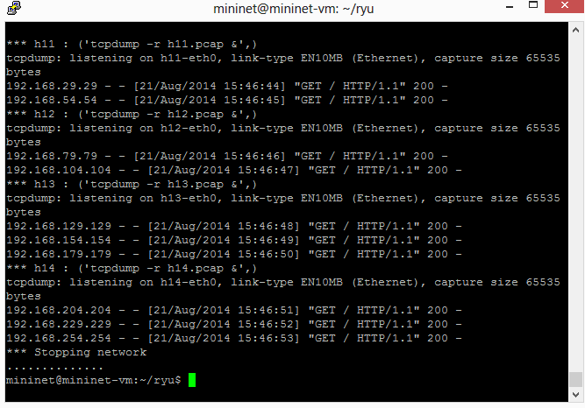
Plot 1 – Results
SDN Workshop 2014
Load Balancer

Slide 7
Plot 2 - 10 clients, 7 servers
Send HTTP-GET from all clients, rebalance and repeat.
End IP | Start IP | Server no.
192.168.36.145 | 192.168.0.0 | 1
192.168.73.35 | 192.168.36.146 | 2
192.168.109.181 | 192.168.73.36 | 3
192.168.146.71 | 192.168.109.182 | 4
192.168.182.217 | 192.168.146.72 | 5
192.168.219.107 | 192.168.182.218 | 6
192.168.255.255 | 192.168.219.108 | 7

Slide 8
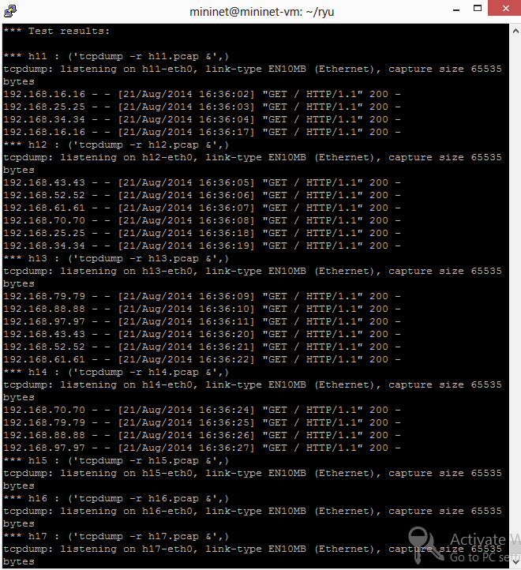
Plot 2 – Results

